Slide 1
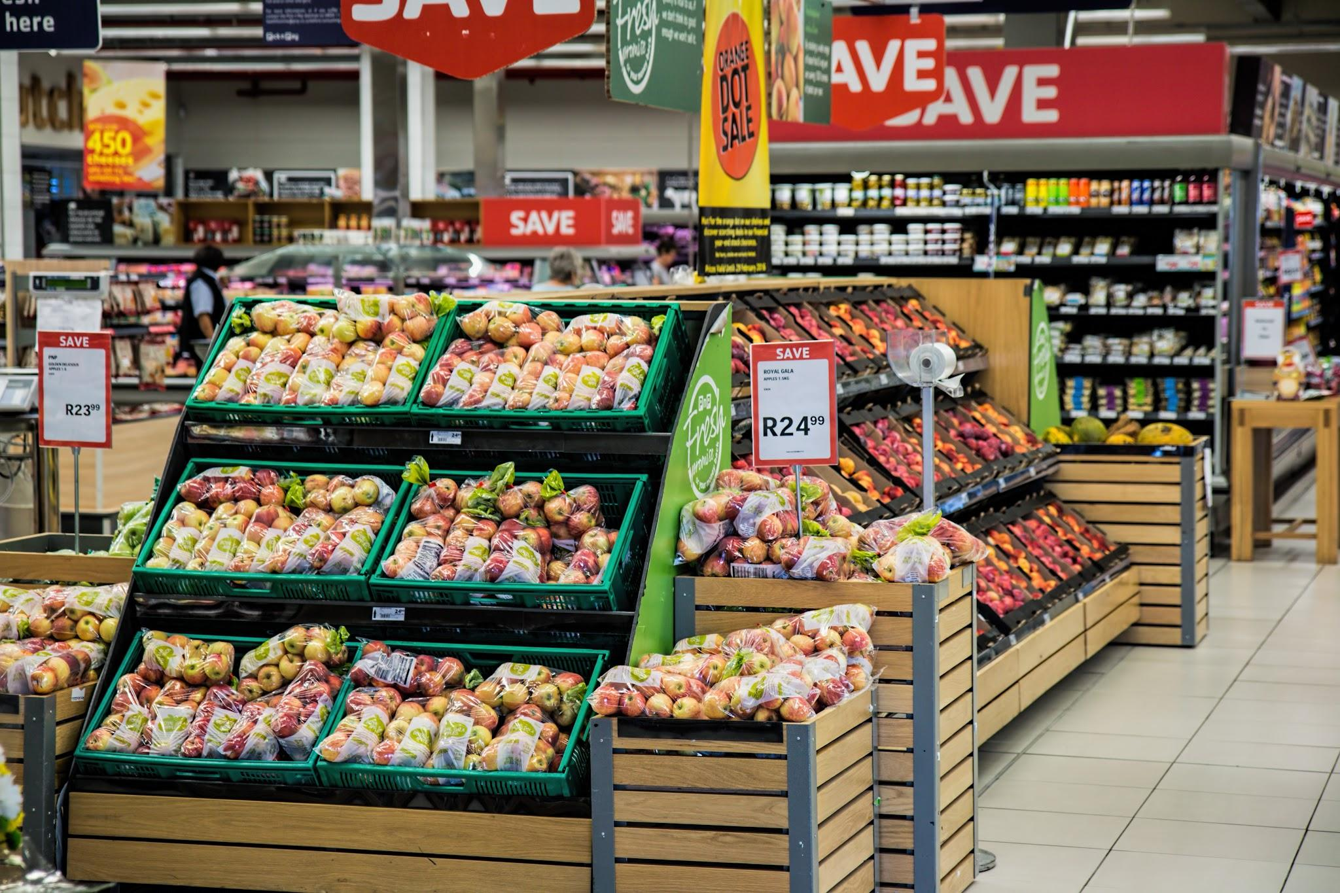
Superstore Marketing campaign
Avwarute Elohor

Slide 2
IRONHACK BOOTCAMP DA JAN 31
Agenda
Intro
Data Overview
EDA: Demographics
Machine learning
Features
Conclusion and Insights

Slide 3

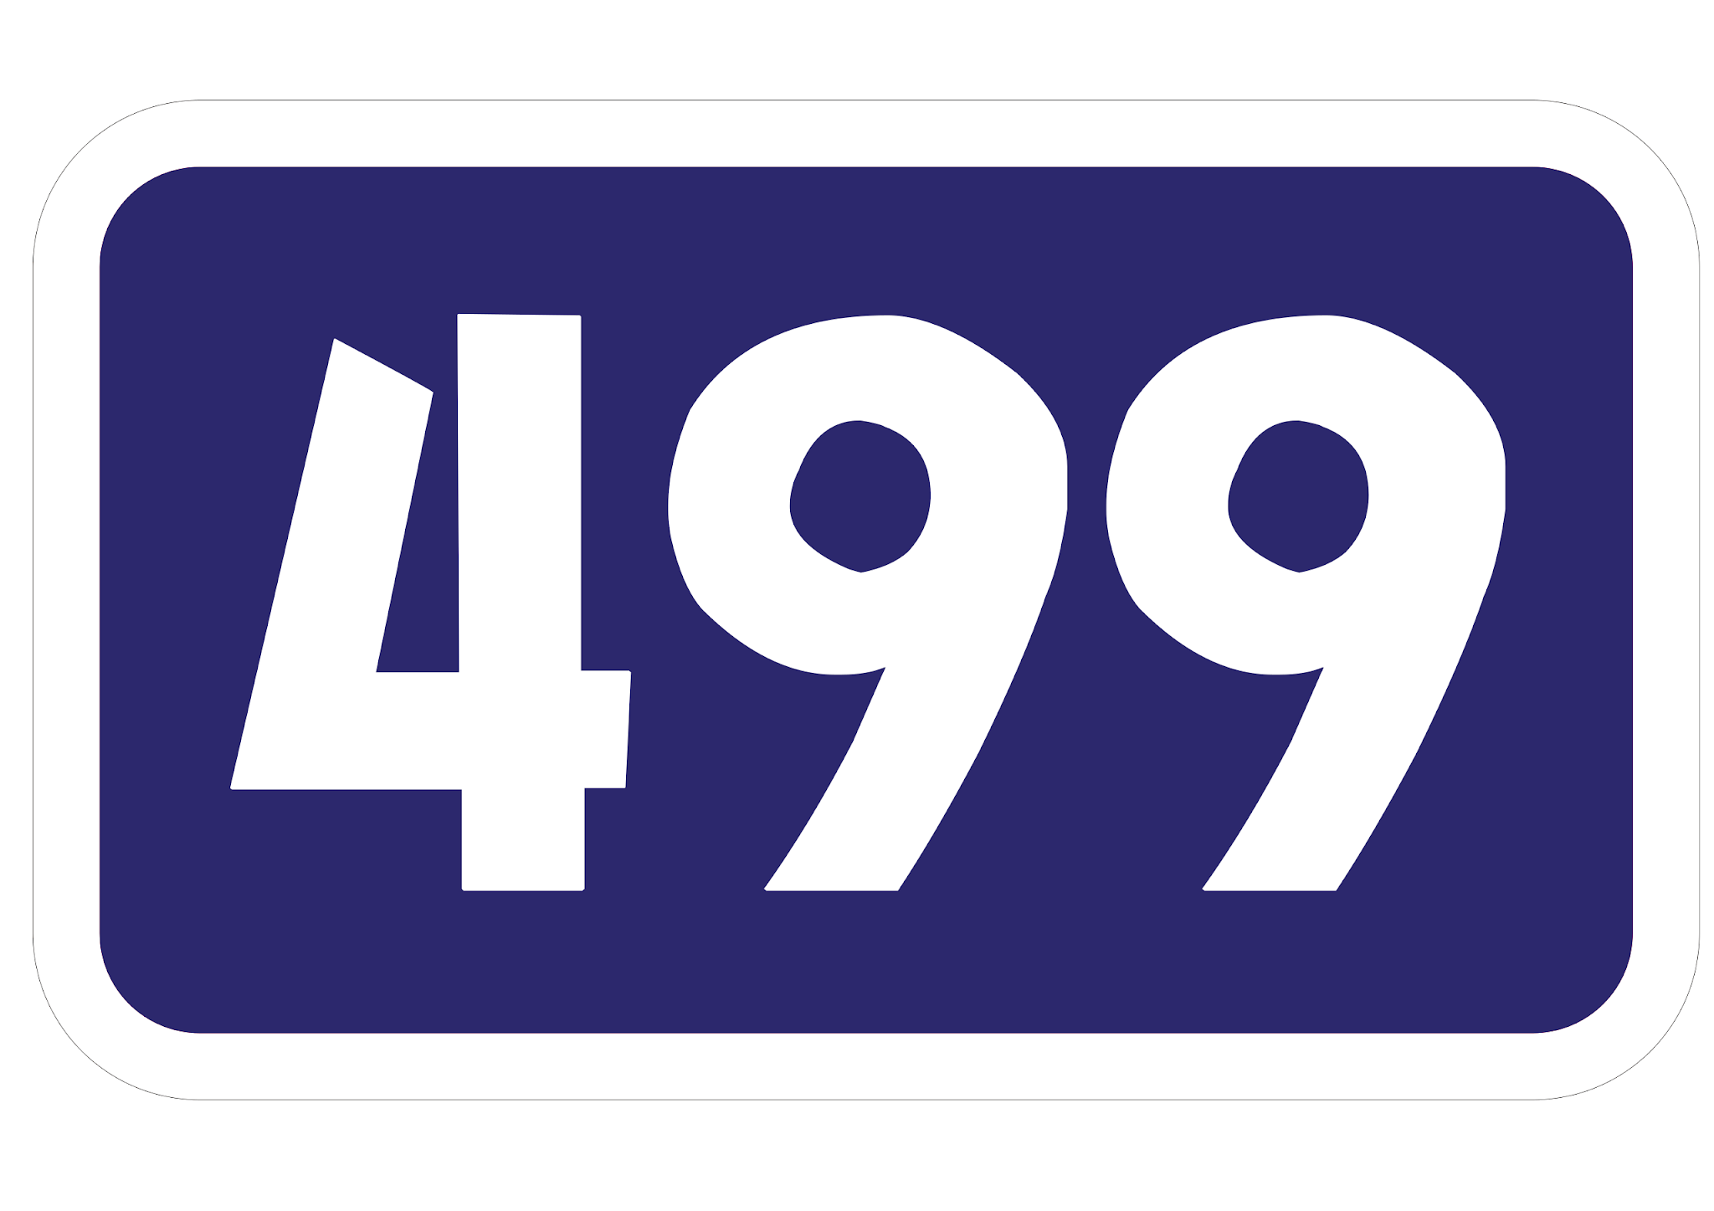
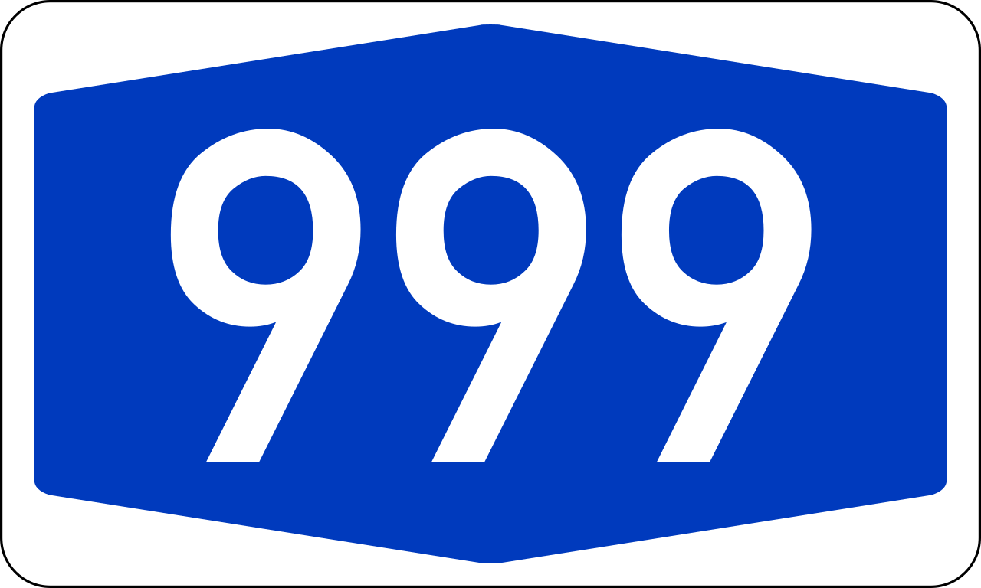
IRONHACK BOOTCAMP DA JAN 31
Introduction
Purpose: The superstore wants to predict the likelihood of the customer giving a positive response and wants to identify the different factors which affect the customer's response

Slide 4
Data overview
Key Columns: Customer demographics, spending behavior, marketing response
Response Variable: Indicates whether a customer responded positively (1) or negatively (0)
Data Source: Superstore customer dataset from kaggle.

Slide 5
Data Cleaning: Handled missing values and outliers.
Feature Creation:
Total Spending: Summing up category-wise spending.
Total purchases
Categorical Encoding: Transformed categorical variables for ML models using label encoding.

Slide 6
EXPLORATORY DATA ANALYTICS

Slide 7
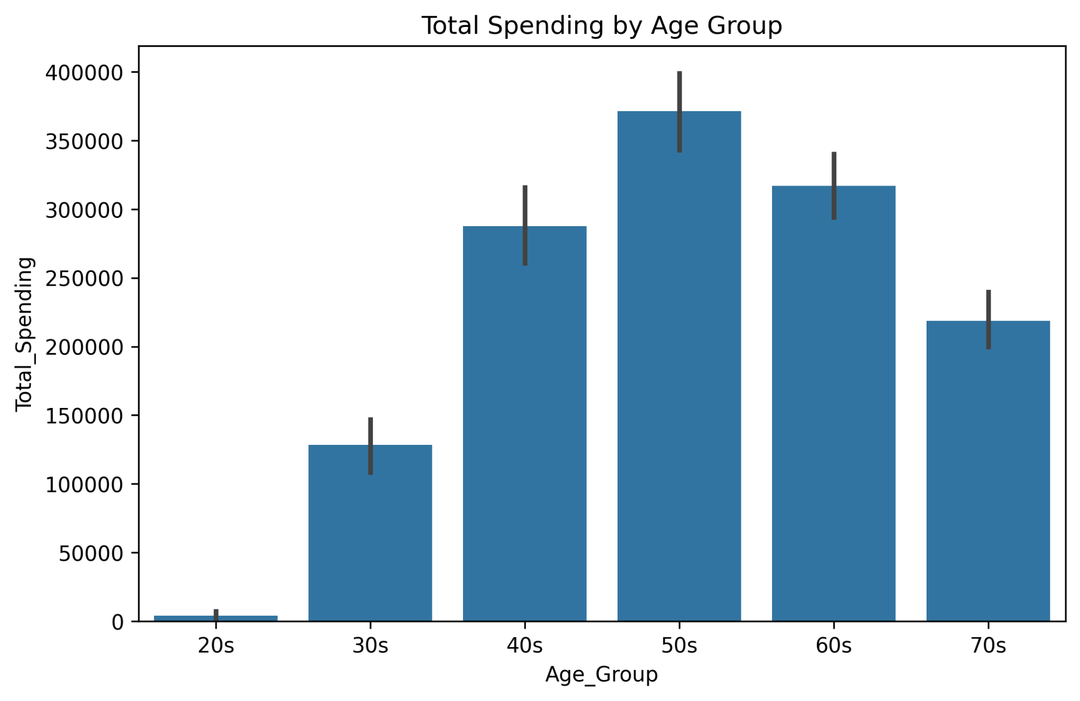
Demographics & Spendings
r
Age Distribution: Majority of customers fall within the 30-60 age group. Customers in their 50s spend the most.

Slide 8
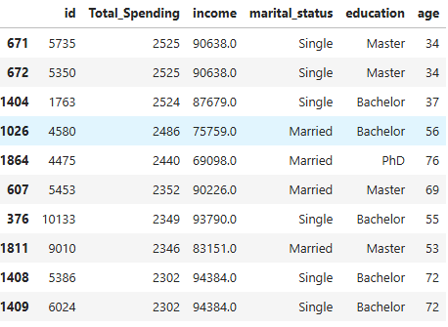
Income Levels: Higher income groups tend to have increased spending.

Slide 9
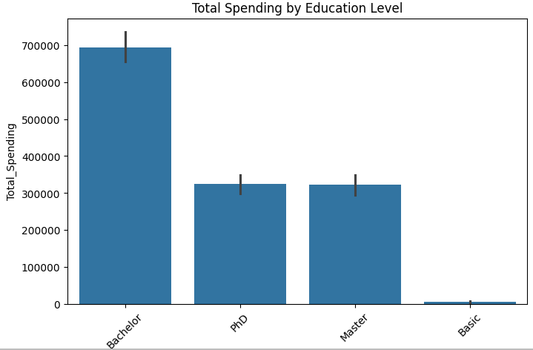
Education Levels: Customers with lower education tend to spend more.

Slide 10
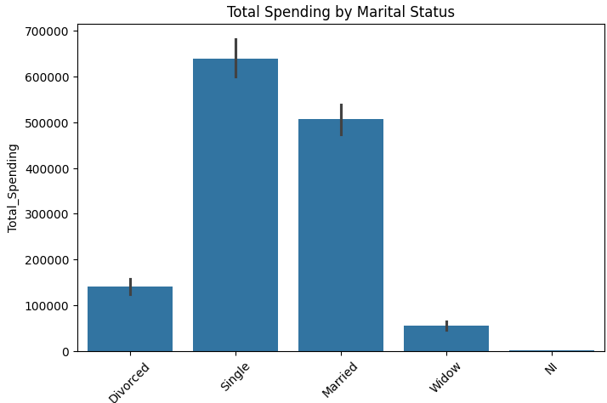
Marital Status: Married customers tend to spend more on family-oriented products.

Slide 11
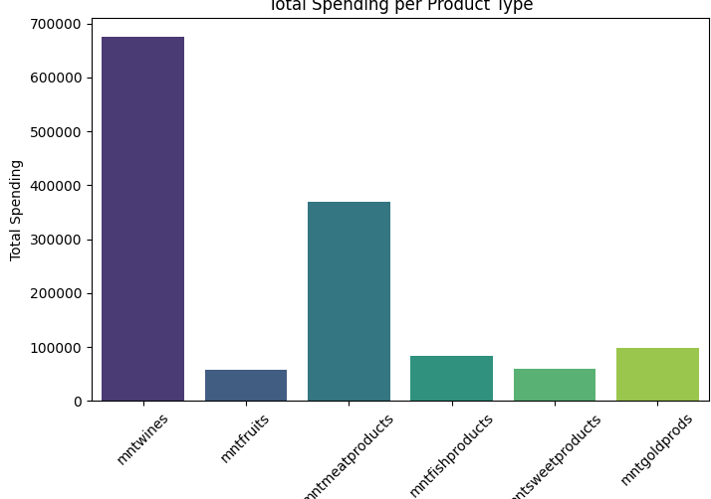
IRONHACK BOOTCAMP DA JAN 31
Spending Trends: Customers spend most on Wines, Meat Products, and Gold.

Slide 12
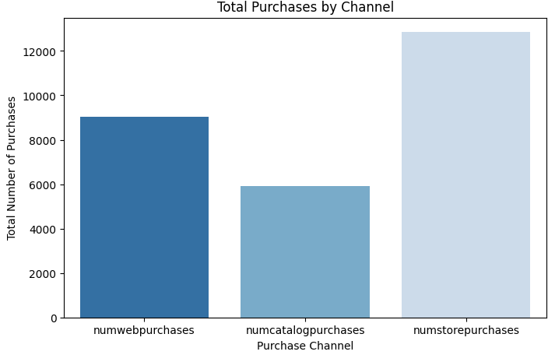

Slide 13
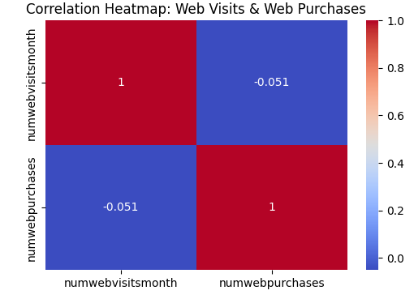

Slide 14
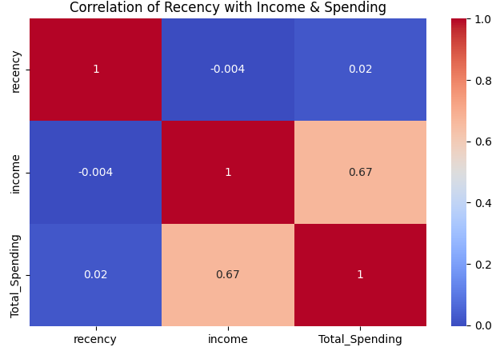

Slide 15
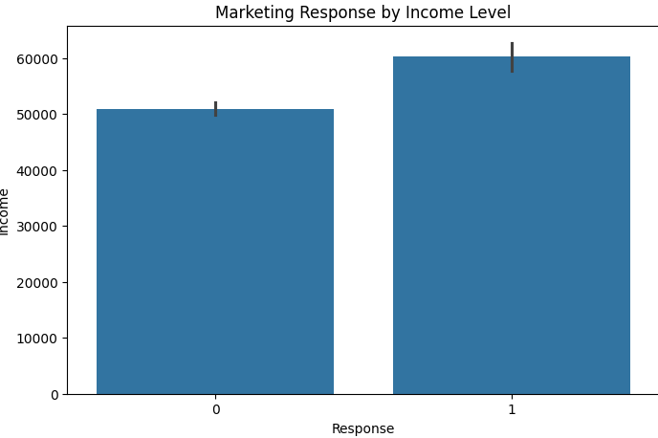
Who is most likely to respond to marketing campaigns

Slide 16
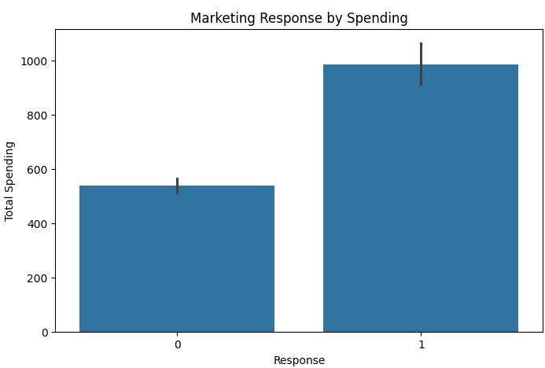

Slide 17
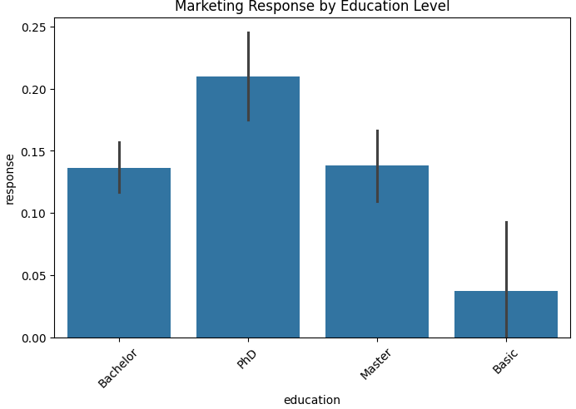

Slide 18
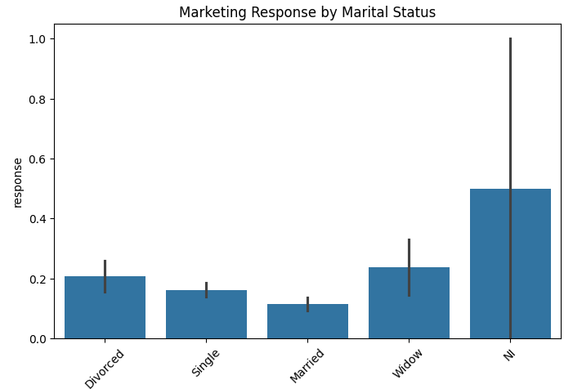

Slide 19
MACHINE LEARNING

Slide 20
Decision Tree
K-Nearest Neighbors (KNN)
Logistic Regression
Performance was evaluated using:
Accuracy
Precision, Recall, and F1-score

Slide 21
IRONHACK BOOTCAMP DA JAN 31
Model Performance Comparison
Decision Tree:
R² Score = 0.68
RMSE = 0.57
KNN:
Accuracy = 84.55%
Logistic Regression:
Precision = 0.75 (Negative Response), 0.76 (Positive Response)
Recall = 0.95 (Negative Response), 0.36 (Positive Response)
Best Performing Model: KNN achieved the highest accuracy.
Notes:
Potential Improvement
Extending the test duration could allow users to better adapt to the new design.
More time may provide clearer behavioral trends and long-term impact insights.
Key Takeaway
Strong initial setup, but a longer test period could enhance validity.

Slide 22
IRONHACK BOOTCAMP DA JAN 31
Performance Metrics 🏁🏎️
Feature Importance Key factors influencing customer response:
Recency of Purchase: Customers who purchased recently are more likely to respond positively.
Total Spending: Higher spenders show greater engagement.
Income Level: Customers with higher income tend to be more responsive.
Household Dependents: Families with more dependents exhibit different spending patterns.
Notes:
1. Completion Rate Percentage of users reaching the final "Confirm" step. Evaluates funnel efficiency & drop-off points. Type: Numerical (Discrete)
2. Process Completion Time Average time taken to complete the online process. Helps optimize user experience & reduce friction. Type: Numerical (Continuous)
3. Error Rate Proportion of steps where users moved backward. Identifies pain points & usability issues. Type: Categorical (Discrete)

Slide 23
IRONHACK BOOTCAMP DA JAN 31
Key Insights:
Recent engagement and higher spending are strong indicators of positive response.
Certain product categories influence response more than others.
Notes:
Our data included some outliers where a few clients spent much longer than others to sign in

Slide 24
Business Recommendations:
Target high-value customers with personalized promotions.
Optimize campaigns by focusing on high-spending and recently engaged customers.

Slide 25
Future Improvements
Improve recall for positive responses.
Explore additional feature engineering techniques to enhance model accuracy.

Slide 26


